Slide 1
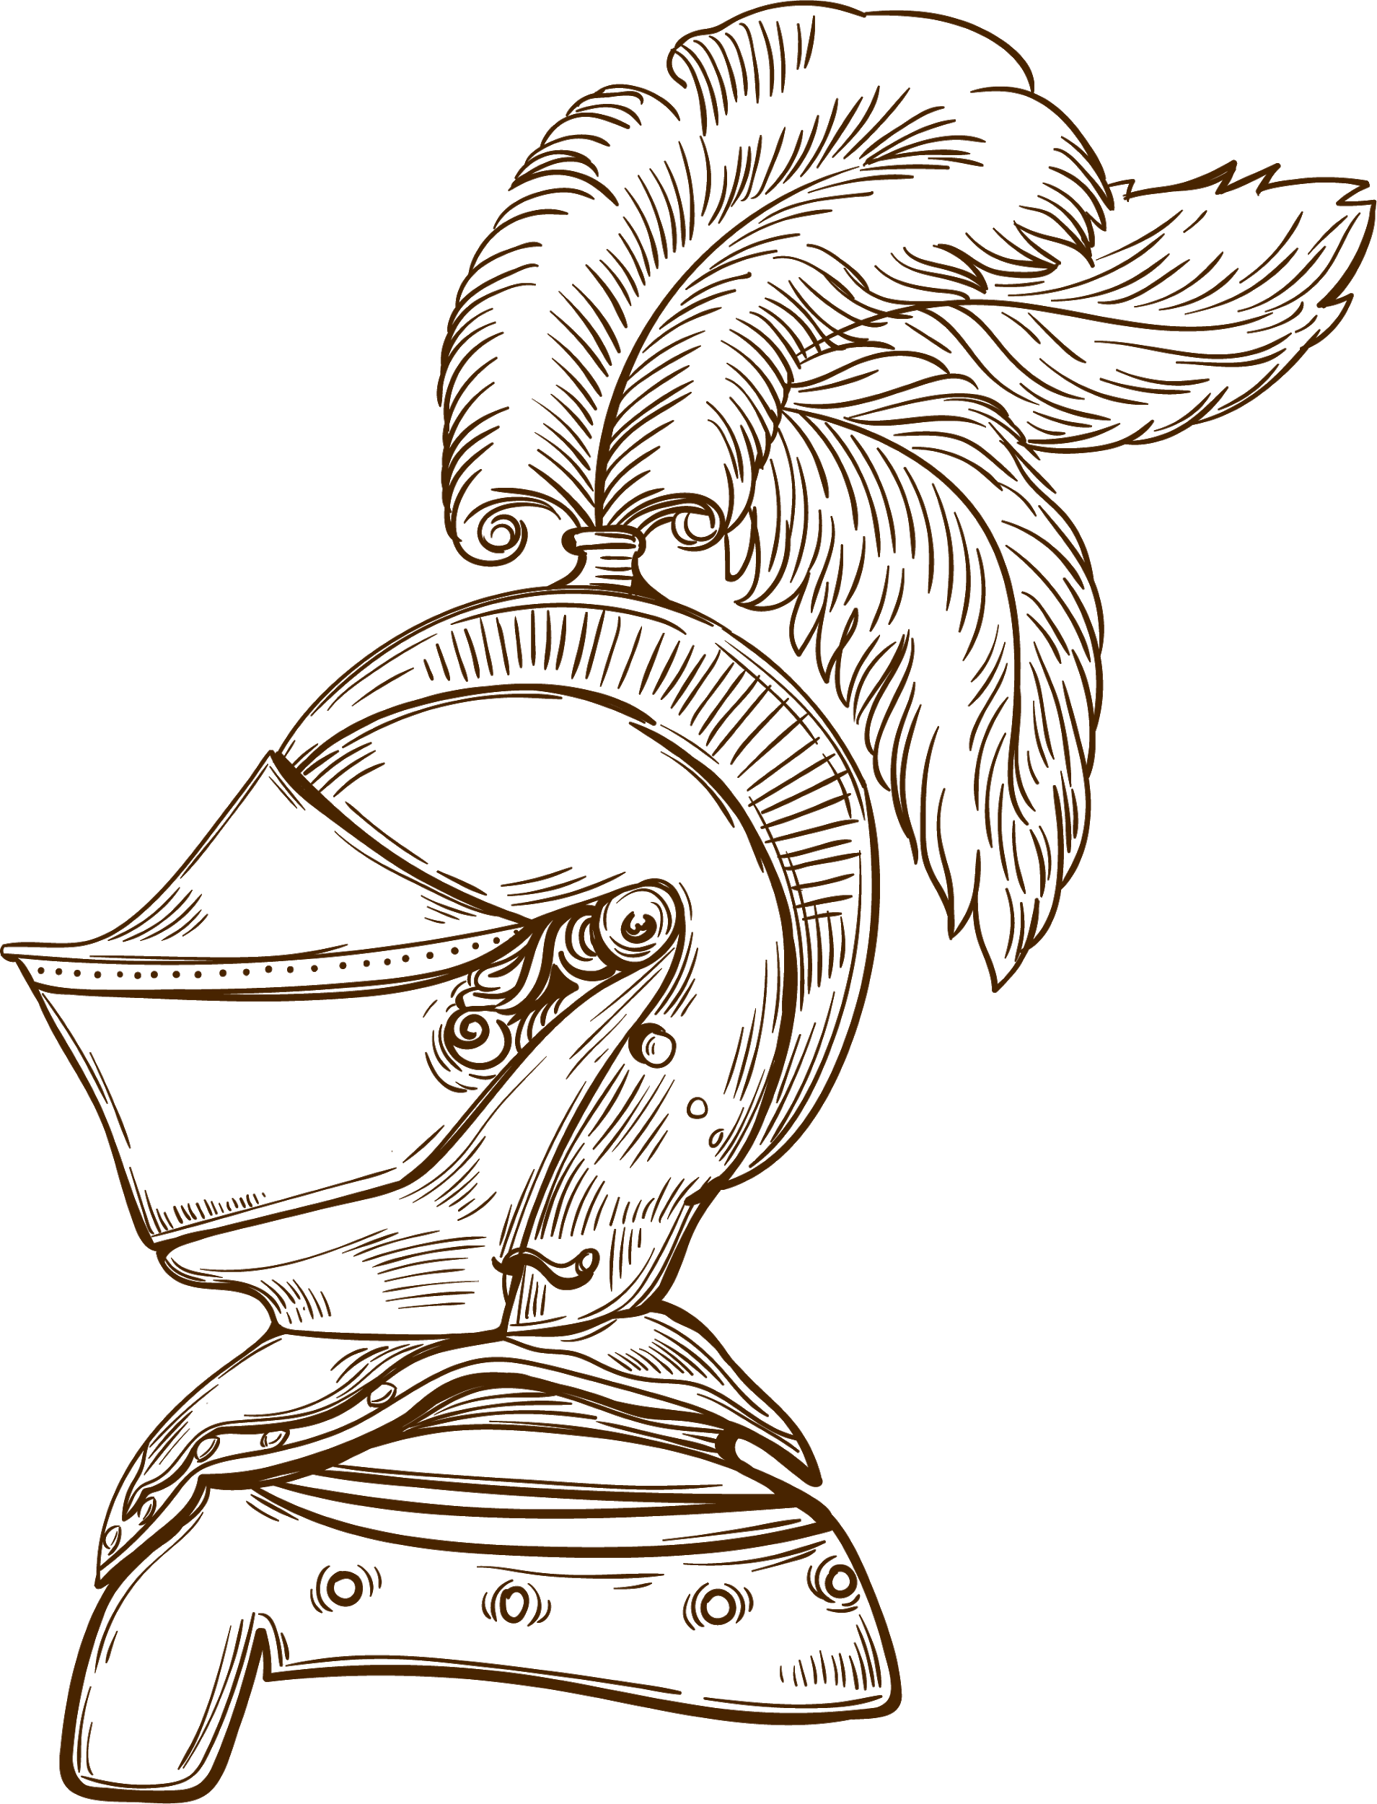
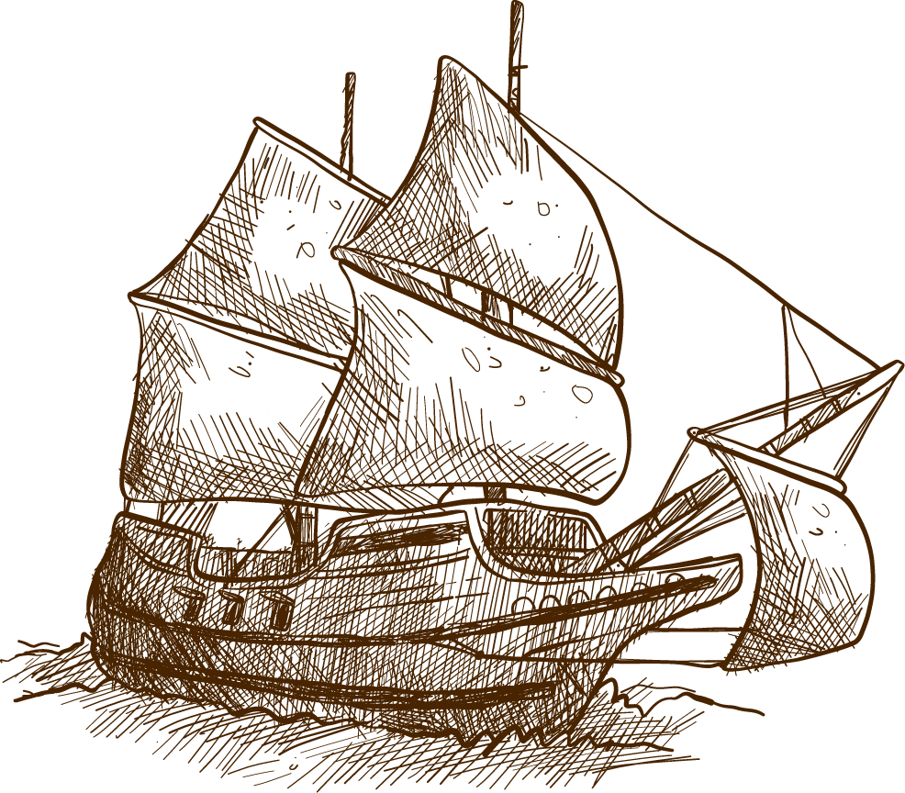


AZERBAIJAN STATE OIL AND INDUSTRY UNIVERSITY
FACULTY: ITIF
GROUP: 604,20E
TEACHER: JAMILA HASANOVA
STUDENT: GUNEL HUMBATOVA
SUBJECT: HISTORY

Slide 2
Azerbaijan Safavis State (XVI-XVII centuries)

Slide 3
Plan of the text:
About Savafid Empire
Establishment of Empire
Internal policy
Reign year of I Shah Abbas
Some Treatments

Slide 4

The Safavid dynasty was one of the most significant ruling dynasties of Iran. The Safavids ruled from 1501 to 1722, and they controlled all of modern Iran, Azerbaijan and Armenia, most of Iraq, Georgia, Afghanistan, and the Caucasus, as well as parts of Pakistan, Tajikistan, Turkmenistan and Turkey.
About Safavi Empire

Slide 5
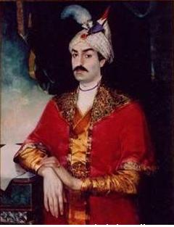

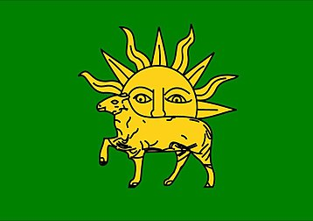

Shah Ismail I founded the Safavid empire when he was 14 years old. He reigned from 1501 to 1524 AD.
The flag of the Safavid state during the reign of Shah Ismail Khatai
The flag of the Safavid state during the reign of Shah Tahmasib
The flag of the period of Shah Abbas I (1587-1629)

Slide 6
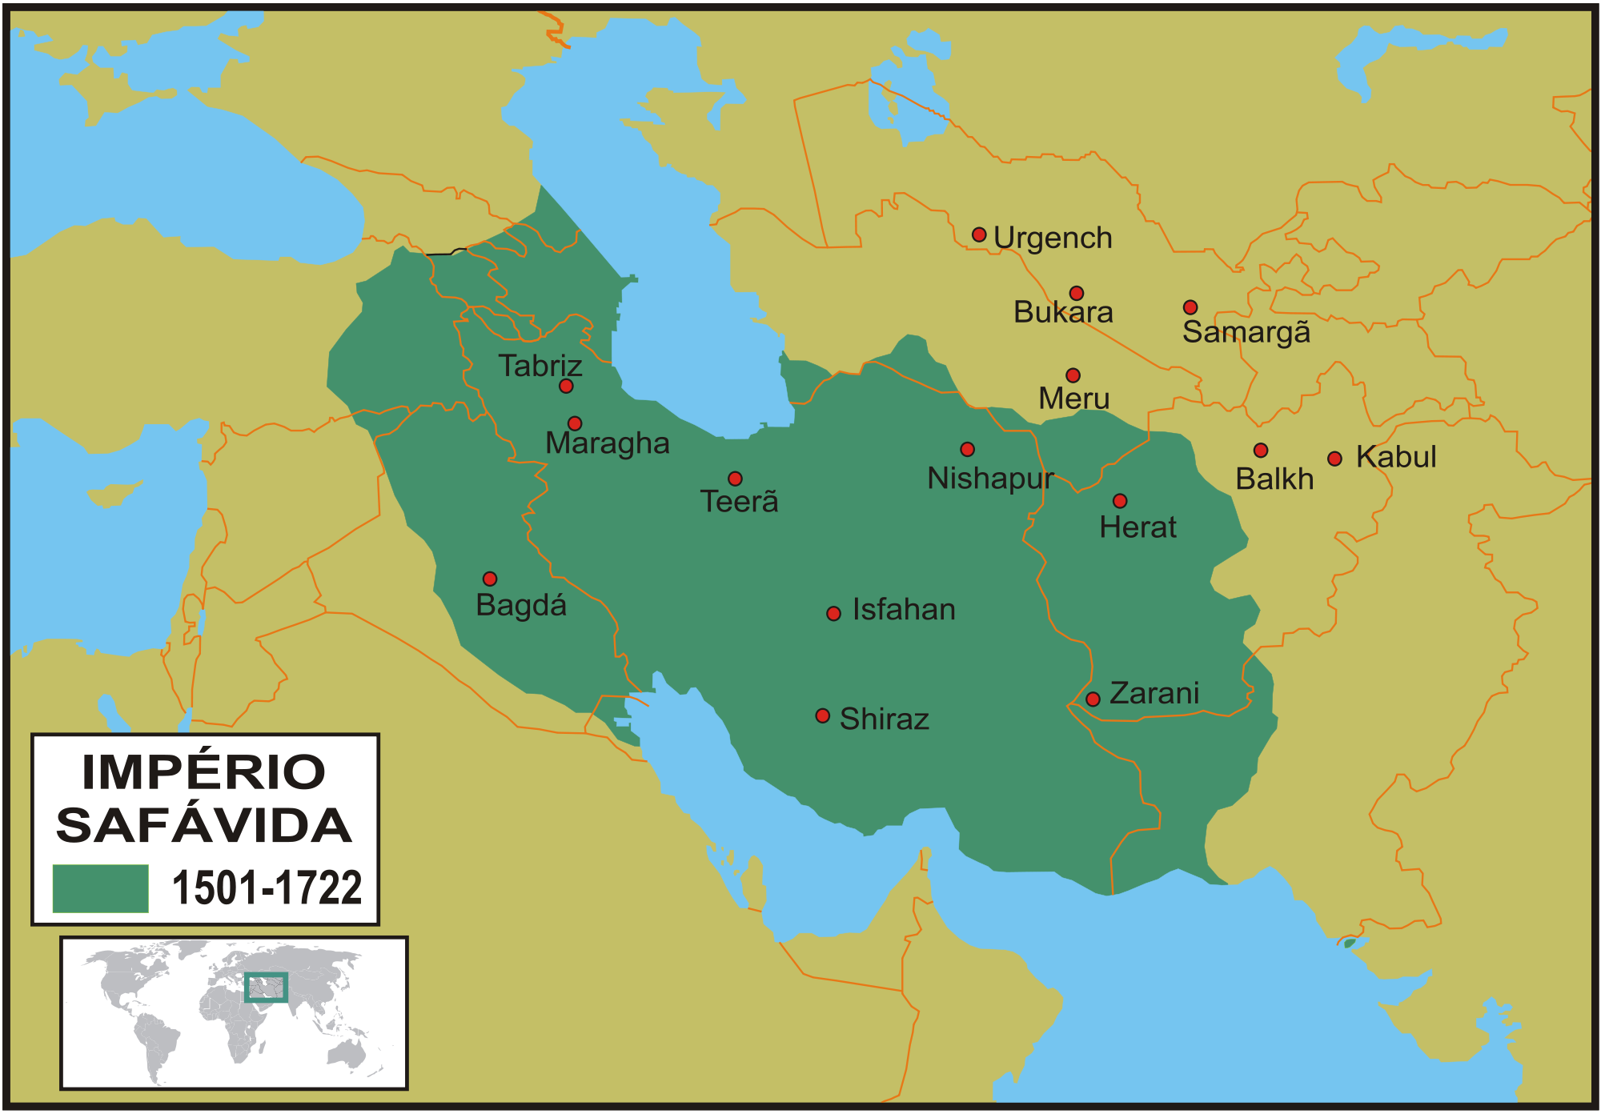
TERRITORY OF SAFAVID EMPIRE

Slide 7
CAPITAL CITIES
Tabriz (1501-1555)
Qazvin(1555-1598)
Isfahan(1598-1736)
RULERS
I Ismayil (1501-1524)
I Tahmasib(1524-1576)
İİ İsmayil(1576-1577)
İ Muhammad(1578-1587)
İ Abbas(1587-1629)
İ Safi(1629-1642)
İİ Abbas(1642-1666)
İ Suleyman(1667-1694)
İ Sultan Hussein(1694-1722)
İİ Tahmasib(1722-1732)
İİİ Abbas(1732-1736)

Slide 8
THE ESTABLISHMENT OF THE EMPIRE
Shah Ismail Khatai, a descendant of Sheikh Safi and an invaluable contributor to the spread of the Shiite sect, began a movement in 1499 to gather his followers. In 1500 he moved to Erzincan. After his supporters in Anatolia, Iraq and Syria joined him, he entered Shirvan in 1500 with an army of 7,000. Shah Ismail, who defeated the people of Shirvan, captured Baku, destroyed the 30,000-strong army of Aghgoyunlu Alvand Mirza near Sharur in 1501, and then entered Tabriz. Here Shah Ismail declared himself the king of Azerbaijan.

Slide 9
THE ESTABLISHMENT OF THE EMPIRE
01
02
03
04
Shah Ismail defeated Aghgoyunlu on June 21, 1503 in a place called Almagulagi near Hamadan.
Shah Ismail captured Kum, Kashan and Isfahan.
He captured Yazd and Kirman in 1504. In 1506-1508 years Qizilbash forces entered to Baghdad and invaded Diyarbakir, Hilat, Bitlis, Archish and Arabin Irak.
in 1510 the battle of Marv Shah Ismail captured Khorasan including Herat, Marv and Balkh cities. The large are from Amudarya till the Euphrates river fell under rule of Safavids. Safavid empire became the powerful state of Near East.

Slide 10
İnternal policy
Creating a centralized state was one of the main ideas in the domestic policy of the founder of the Safavid state. The need to revive trade, crafts and the restoration of normal economic life demanded it.
One of the most important measures of Shah Ismail I was the implementation of religious reform. In the autumn of 1501, from the first day of the Safavid rule, the sect of imams of the Shiite sect of Islam (12 imams) was declared the state religion.

Slide 11
İnternal policy
During the Safavid rule, the culture of public administration in Azerbaijan rose even higher. The Azerbaijani language became the state language. As a result of successful reforms and domestic and foreign policies implemented by Shah Ismail, Shah Tahmasib, Shah Abbas and other Safavid rulers, the Safavid state became one of the most powerful empires in the Middle East. An excellent public administration mechanism was created to govern the vast Safavid Empire. Along with secular power, the Safavid rulers seized religious power. Thus, the central government was further strengthened. As a result of the reforms carried out by the Safavid rulers, especially Shah Abbas, the Safavid military forces became one of the most powerful armies in the world. During the rule of the Safavids, the role of the Azerbaijani language in the entire Middle East increased. Diplomatic talks with foreign ambassadors to the Safavid palace were, as a rule, conducted in the Azerbaijani language.

Slide 12
 | War | Ruler of Safavids | Ruler of Ottoman | Peace treaty
1 | Safavid-Osmanli War (1514-1555) | I Ismayil,I Tahmasib | I Salim, I Suleyman | Amasya
2 | Safavid-Osmanli War (1578-1590) | Mahammad Khudabanda, I Abbas | III Murad | Istanbul(1590)
3 | Safavid-Osmanli War (1603-1612) | I Abbas | I Ahmad | Serab
4 | Safavid-Osmanli War (1616-1618) | I Abbas | I Mustafa, II Osman | Merend
5 | Safavid-Osmanli War (1623-1639) | I Abbas, I Safi | IV Murad | I Qasri-Shirin
6 | Safavid-Osmanli War (1623-1627) | II Tahmasib | III Ahmed | Hamadan
7 | Safavid-Osmanli War (1733-1636) | III Shah Abbas | I Mahmud | Istanbul(1736)

Slide 13
In the first days of the reign of Shah Abbas I, the internal and external situation of the state was very difficult.
Therefore, he implemented several reforms:
Shah Abbas's first meeting with the nobles of Gizilbash showed that in order to save the country from the threat of destruction, a strong army must be created and stability must be restored in the country.
Shah Abbas I began negotiations with the Ottomans in order to gain time to resolve internal problems.
To save the Safavid state from its predicament, Shah Abbas I had to solve three important tasks: first, to end the internal unrest in the country and restore order, improve the financial situation, create a strong regular army and restore the lost territorial integrity of the state.
In order to improve the financial situation of the state, Shah Abbas I demanded that all those who were promoted to high state positions pay a certain amount to the treasury in the name of a gift. This laid the foundation for the development of the central provinces of the state. As a result of the reforms implemented by Shah Abbas, political stability was restored within the country. The emergence of internal stability has allowed for socio-economic and administrative reforms. The financial measures enriched the state treasury and the productive forces were revived. The Safavid state was significantly strengthened socio-economically and politically. As a result of the military reforms, various types of troops were formed, consisting of Redheads, slaves, riflemen and artillery. The resistance of the nomadic nobles was broken. Kizilbash cavalry detachments consisting of Azerbaijani Turks were restored. As a result, a 116,000-strong regular army equipped with firearms was created.

Slide 14
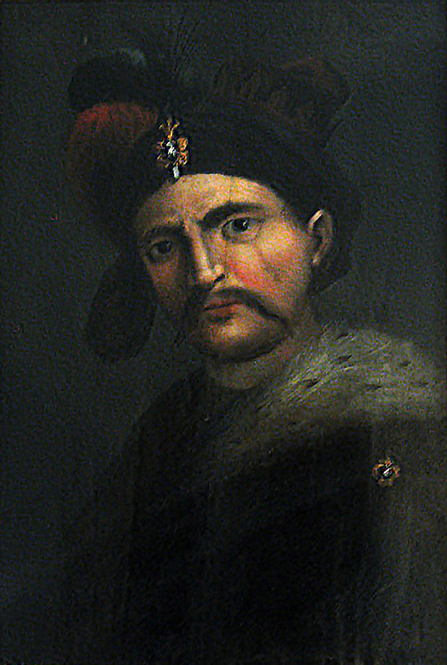
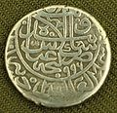
Adhering to the foreign policy of his great-grandfather Shah Ismail, Shah Abbas I pursued an active foreign policy, expanding trade relations with European countries and Russia, and strengthening military-political negotiations with Western countries to provide the necessary assistance in returning the lost territories. He began negotiations with Venice, Germany, Spain, the Pope, Britain and the Principality of Moscow to establish diplomatic relations. The rulers of Germany and Spain promised to support the Safavids in the war against the Ottoman Empire.
At the end of the 16th century, Shah Abbas began to pursue an active foreign policy. During this period, the foreign policy of the Safavid state consisted of three main directions: the recapture of Khorasan from the Sheybani state to ensure the security of its north-eastern
borders; Recapture of the Safavid lands occupied by the Ottoman Empire as a result of the war of 1578–1590; To end Portuguese hegemony in the Persian Gulf and gain access to the Indian Ocean. Starting from the first of these goals, Shah Abbas defeated the Sheybani and reunited Khorasan with the Safavid state.
Shah Abbas I
Silver coin of the period of Shah Abbas I.

Slide 15
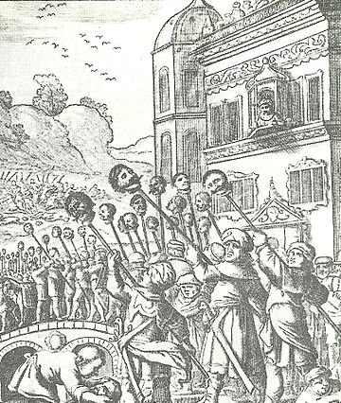
Safavid-Ottoman War (1603-1618)
After serious military training, Shah Abbas I set out for Tabriz on September 14, 1603 to retake the lands occupied by the Ottomans. They reached the gates of the Tabriz fortress in fourteen days. Seeing the approach of the Red Army, Tabriz and its environs began to protest against the Ottomans. On October 21, 1603, Shah Abbas I captured Tabriz. Julfa and Nakhchivan were captured by the Red Army without a fight. The Ottoman garrison in the city did not resist and surrendered. Upon learning of the arrival of the Red Army, the people of Ordubad revolted against the Ottomans.
A description of the post-siege massacre of a European traveler who saw the siege of Tabriz. 1603.

Slide 16
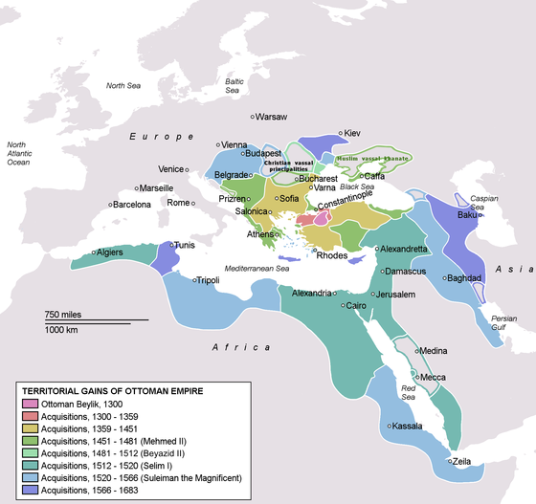
Therefore, the city was destroyed by the Ottomans. Ordubad was captured with the help of the population. Shah Abbas began to take major measures in the late 16th century to return much of Azerbaijan, the territory of the South Caucasus, to the Safavid state. A new military conflict with Ottoman Turkey was inevitably becoming a reality. On July 29, 1599, Shah Abbas defeated Dinmahammad khan's Uzbek army near Herat and took control of Mavarannahri. Although the Shah's next visit to Balkh in 1602 was unsuccessful, he demonstrated the military might of the Safavid state. This was a "training ground" for the Shah's army's main battle against the Ottomans in the west.

Slide 17
Istanbul Peace Treaty
On November 20, 1612, the Safavid-Ottoman peace was concluded in Istanbul. According to the peace treaty, the borders defined by the peace of Amasya in 1555 were accepted.
According to the Istanbul Peace Treaty signed in 1612, the Ottoman state renounced the territories occupied by Iran, and the Safavid-Ottoman border, which existed until 1578, was restored. Dagestan, the North Caucasus and Western Georgia were given to the Ottomans, Western Iran, Yerevan, Nakhchivan and Karabakh together with the northern part of Azerbaijan to the Safavids; Sunnis should not have been blasphemed in Iran. [36]

Slide 18
Under the conditions set by the Ottoman state, Shah Abbas I paid an annual tribute of 200 tons of silk; He undertook not to obstruct the Ottoman march to destroy the fortress they had built on the banks of the Terek River. In addition, the Safavids promised that they would not help the beys who rebelled against the Ottomans on the Iraqi border, and that the Ottoman government, including Dagestan's Shamkhali, would be recognized. The agreement also stated that in the Safavid state, Shiites would not blaspheme Sunni elders, and pilgrims from the Safavid country would travel through Aleppo-Damascus, not Baghdad or Basra. [37]
It was the first time that the "North Caucasus issue" was reflected in the Istanbul peace agreement. Although it remained in the eastern Meskhetian and Akhalsik Safavid states due to the peace of 1555, Istanbul remained under the control of the Ottoman state when the peace was concluded. According to this agreement, Shahrizar, a part of Kurdistan and a part of Baghdad province were given to the Ottoman state. Therefore, Shah Abbas I was not fully satisfied with the terms of the peace, as he did not fully restore the peace treaty of Amasya in 1555.

Slide 19
Serab Peace Treaty
The decisive battle between the Safavids and the Ottoman army took place on September 10, 1618 in the plain between the settlements of Arashtaban and Sakamsaray in the province of Sarab, in a place called Sinig Korpu. The Ottoman army was severely defeated, losing 15 thousand soldiers. Hasan Pasha, the prince of Erzurum, was killed in the battle, Mehmed Pasha, the prince of Van, and Mirza Bey, the prime minister of the Crimean khan, were captured. Janibey escaped and saved his life.
After this defeat near Sarab, Khalil Pasha withdrew and began peace talks. On September 26, 1618, a peace treaty was signed between Khalil Pasha and Shah Abbas in Marand. The main difference between this peace and the peace of Istanbul in 1612 was that the Safavids reduced the amount of 200 silk sisters a year to 100. The Ottoman Sultan Osman II left for Europe on September 29, 1619, ratifying the Safavid-Ottoman peace treaty. 1618 Shah Abbas violates the Safavid-Ottoman peace treaty In the 1920s, chaos broke out in the Ottoman Empire. The Janissaries were arbitrary in the country, overthrowing the sultans and replacing them with others. Taking advantage of this, Shah Abbas captured the Iraqi Arab cities of Baghdad, Karbala, Najaf, Mosul and Kirkuk in 1622-1623. Shortly afterwards, according to the peace of 1618, the Ottoman fortress of Akhalsik was captured.

Slide 20
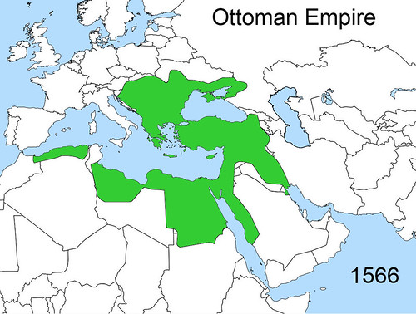
Amasya Peace Treaty
In 1548, Sultan Suleyman I attacked Azerbaijan for the third time and captured Tabriz. However, the Sultan still failed to establish himself in Azerbaijan and left the country. In 1550, Shah Tahmasib I sent an envoy to the Sultan to offer peace, but the Sultan still refused. In this case, in 1552, the Shah captured Van, Kars, Vostan and Adilchavaz. Prince Ismail defeated the Ottoman troops near Erzurum and captured Erzurum. Sultan Suleyman I last invaded Azerbaijan in 1554, but failed. The resistance of the population, the successive victories of the Qizilbash did not allow the Sultan to capture Azerbaijan, and in 1555 a peace treaty was signed in Amasya between the Ottomans and the Safavids, albeit belatedly. According to the agreement, eastern Anatolia, Imereti, Guria, Arab Iraq were given to the Ottomans, Kartli, Kakheti and Meskhetia to Azerbaijan.

Slide 21
Like previous peace agreements, the Marand peace was not valid. In 1623, a new war broke out between the parties. During this period, the main struggle was in Arab Iraq. Safavid ruler Shah Abbas ruled Baghdad, Karbala, Najaf and others. captured Arab Iraq along with the cities. In the South Caucasus, Akhalsikhe was captured. After the death of Shah Abbas, the war was continued by Safi I (1629-1642), who came to power. The Ottoman sultan Murad IV (1623-1640) began to march to Azerbaijan. In August 1634, the Ottomans captured Yerevan and headed for Tabriz. Tabriz was evacuated. The Ottomans, who captured the city without a fight, could not stay here long. In April 1635, the Safavids managed to liberate Yerevan. The battles around Baghdad were in favor of the Ottomans, and the city was captured. Peace talks have begun between the parties. On May 17, 1639, Safi khan (on the Safavid side) and Gara Mustafa Pasha (on the Ottoman side) signed a treaty in Qasri-Shirin.
Qasri-Shirin Peace Treatment

Slide 22
This treaty mainly maintained the 1612 Safavid-Ottoman peace. On May 17, 1639, in Qasri-Shirin, after three days of negotiations with the Safavid ambassador Sari khan Ottoman Gara Mustafa Pasha, they signed a peace treaty. According to the agreement, the Ottoman-Safavid war ended. In the Iraqi Arab Ottomans, the lands east of the Chain Fortress remained with the Safavids. According to the treaty, the Safavids guaranteed that they would not attack the fortresses of Van and Kars, as well as Akhalsik. In order to prevent each side from gaining a large territory, it was proposed to establish a "neutral zone". According to Mohammad Masum, the fortresses of Maku, Kotur and Magazburd in western Azerbaijan were to be demolished. was sent to Istanbul through Mahammadgulu khan. Sultan Murad IV also ratified the treaty.
Terms of Qasri-Shirin:

Slide 23
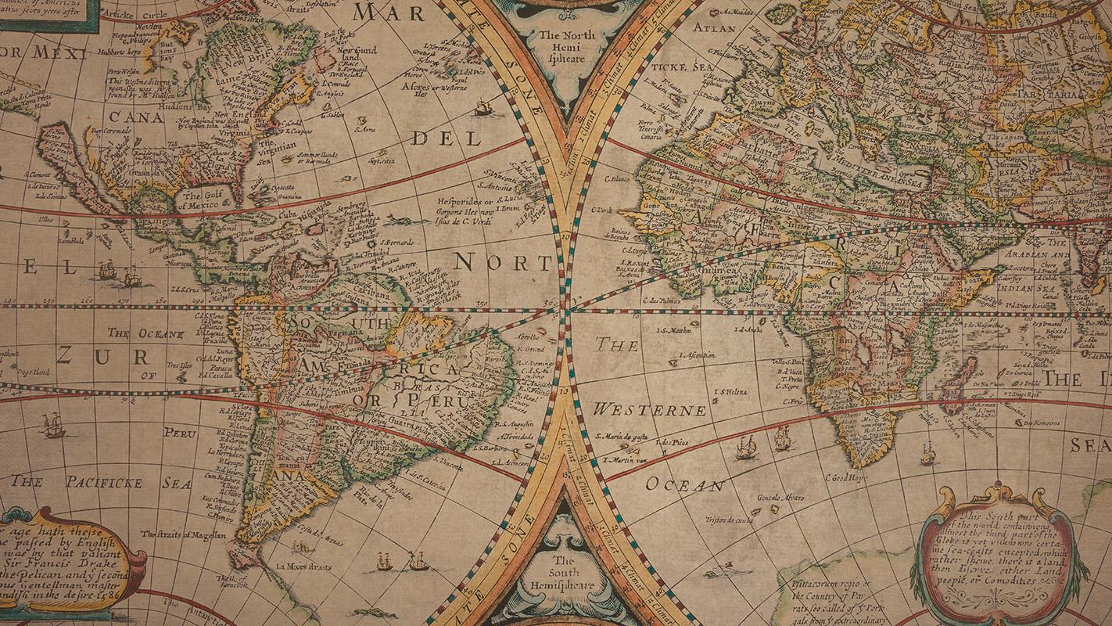
RECOURCES:
https://en.wikipedia.org/wiki/Ottoman%E2%80%93Safavid_relations
https://brill.com/view/book/edcoll/9789004346048/B9789004346048_002.xml
http://oval.az/internal-and-foreign-policy-of-shah-ismail-i/
https://apa.az/az/daxili_siyaset/-192961
https://www.wikiwand.com/az/S%C9%99f%C9%99vi-Osmanl%C4%B1_m%C3%BCharib%C9%99si_(1603-1618)
https://www.wikiwand.com/az/Amasya_s%C3%BClh_m%C3%BCqavil%C9%99si
https://az.wikibooks.org/wiki/Az%C9%99rbaycan_tarixi/%C5%9Eah_%C4%B0smay%C4%B1l%C4%B1n_daxili_v%C9%99_xarici_siyas%C9%99ti
https://az.wikipedia.org/wiki/Q%C9%99sri-%C5%9Eirin_s%C3%BClh_m%C3%BCqavil%C9%99si
https://az.wikipedia.org/wiki/I_%C5%9Eah_Abbas

Slide 24
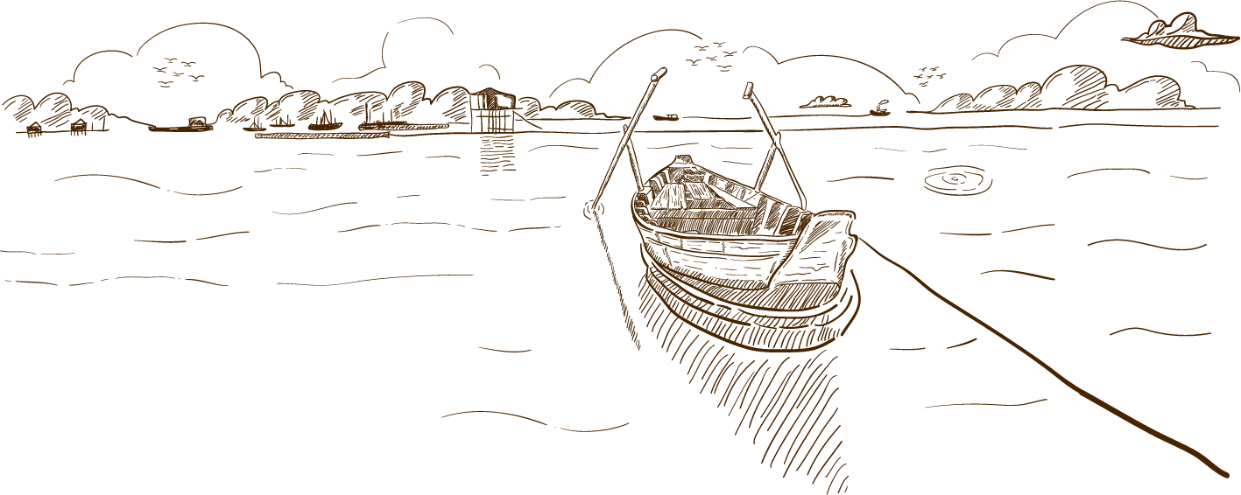

THANKS
Please keep this slide for attribution

